Slide 1


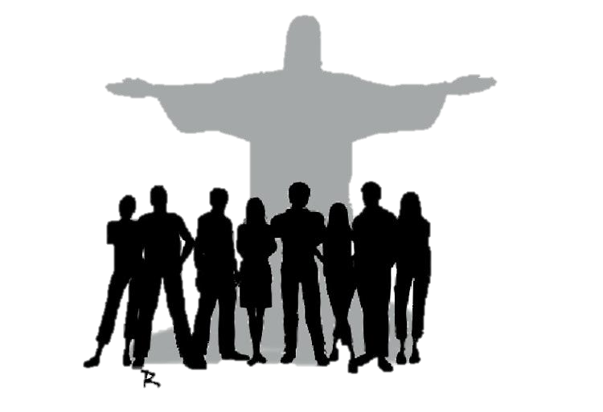

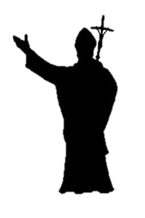

The process for Synod 2023 at the Diocesan Phase

Slide 2
1
Synod
Synod (Gk) = Walking together
To “walk together”, we need to let ourselves be educated and transformed (PD 9).
An ancient and venerable word. (PD10)
Christians were called “The Way” (Acts 9:2; 19,9.23; 22,4; 24,14.22) as Jesus is the Way!
“Church and Synod are synonymous.” St. John Chrysostom
All the Baptized participates in Christ’s priestly, prophetic, and kingly functions.
Recent Synods after Vat.II. A Consultative Body for the Pope.

Slide 3
General Process of a Synod
2
Pope
Secretariat
Lineamenta (outline)
Instrumentum Laboris (Working Document
Propositions (to Pope)
Synod
Message to the People of God (Published)
Apostolic Exhortation (by Pope. Published)

Slide 4
3
Phases of Synod 2023
Earlier Decision: October 2022, “For a synodal Church: communion, participation and mission”
Later Decision on 24 April 2021: Pope Francis proposed a new approach with various phases for the synod!
2. Diocesan Phase (Oct 2021-April 2022): Lineamenta and Questionnaire with the help of a vademecum of guidelines will be discussed in dioceses.
1.Opening of the Synod: 9-10 Oct. at Vatican, 17 Oct. at Dioceses
4. Universal Church Phase (October 2023): 2nd Instrumentum Laboris to the Synod Fathers
3. Continental Phase (Sep 2022-March 2023): 1st Instrumentum Laboris (working Document)

Slide 5
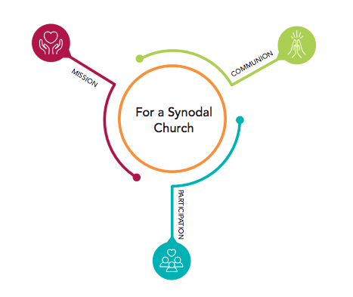
5
Theme For Synod 2023
Communion, Participation and Mission
Communion = fellowship, love and unity as expressed in Trinity.
Participation = including all excluding none, listening and dialoguing with an open mind, for all stages and ages.
Mission = that spreads to the entire universe, as a single family, as the identity of the Church

Slide 6
Content and Method for Diocesan Phase at Parish level

Slide 7
Structure of Parish Animation
2
Parish Synod Report
Parish Priest
Parish Contact Person(s)/Synod Core Team
Parish Synod Committee
Coordinators
Coordinators
Coordinators
Church Associations
Church Groups
Social Groups
Social Associations
Ecumenical /Interreligious groups
Deanery Core Team/ Diocesan Core Team.
Working Document for
Synthesis
Final Report
Report
Synthesis

Slide 8
3
Normal Structure of a Consultation Session
1. Prayer : Prayer for the Synod & then Reading of the Word (Ideal Passages: one of the images of Synodality from PD.)
Make short reflection on the image.
2. Project/ exhibit Logo. Make a prayer/reflection based on the logo.
3.Introduce: purpose of Synod and purpose of consultation in Brief.
4. Consultation Questions: Choose the questions from the Questionnaires . Start with basic questions a) Are we together ? b) if Yes how ? c) if no Why not ? d) What needs to be done.
5.Listen: Try to involve all. Animator not to talk too much at this time.
6.Evaluation: Feed back on how they journeyed the process.
All the consultation sessions should include two levels of sharing: How we journey together as people of God (Faithful). How we journey together as a human family (All humans) or even as a universal family (Environment)

Slide 9
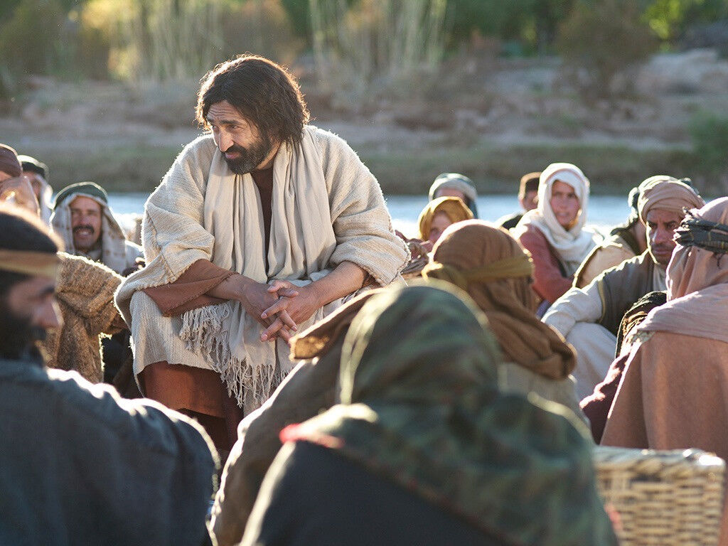
6
Two Images of the Synod from the Bible
1. Image of Jesus, Crowd & Apostles. (PD 17-21)
Jesus shows no partiality (marginalised).
Crowd indicates everyone, not chosen few alone, (Samaritan woman, Canaanite woman, centurion,…).
Apostles indicate not exclusive privilege of power but inclusive ministry of blessing to all.
All the three must be present for a true Church.

Slide 10
6
Two Images of the Synod from the Bible
Jesus, Crowd, The Apostles
Church = A Political Contract
Jesus, Crowd, The Apostles
Jesus becomes ideology or myth by the crowd without His mediators.
Jesus, Crowd, The Apostles
Church becomes sectarian and self-referential form of religion

Slide 11
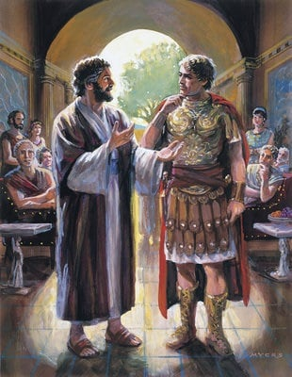
6
Two Images of the Synod from the Bible
2. Image of the early Church: Peter and Cornelius. A Double Conversion. (PD 22-24).
Peter had to deny his religious traditions (eating unclean food) to be transformed.
He becomes an instrument of life and communion with God and others.
No human being is unworthy in the eyes of God/
Both Cornelius and Peter involve other people in their journey of conversion, making them companions in their journey.

Slide 12

Holy Eucharist: Shines like the Sun
9
Logo
Tree of Life: Cross, horizontal lines of hands and Hoiy Spirit
People of God: Walking together (Synodality), 15 silhouettes→ Entire humanity.

Slide 13
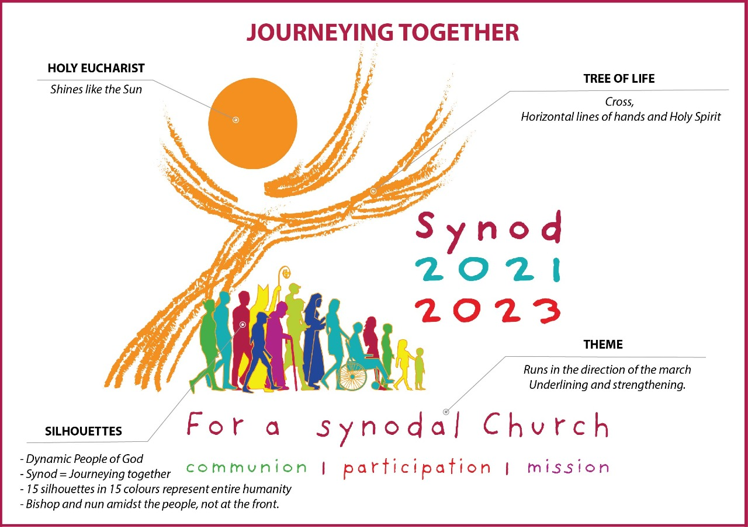
Logo

Slide 14
8
What is the purpose this Synod 2023?
1.To be witnesses of God’s love
2.To live as a participatory and an inclusive process in the church, especially listening and hearing those at periphery.
3.To recognise the wealth and variety of gifts in the Church.
4.To explore participatory ways of living the mission.
5.To examine the responsibility and power in the Church
6.To help the church as credible partner towards dialogue (faiths & other Christians), fraternity, inclusion, participation and fraternity for a better world.
7.To Value Minority Reports not just principle of convergence or majority in the consultation process.
8.To experience a new way of being church, walking together, the synodal way.

Slide 15
7
Ten Themes of Lived Synodality
How do we discern and decide in the Church?
How are the people formed in the Church?
How do we enhance our relationship with all Christians?
How is authority exercised in the Church?
What is our relationship with our people & other faiths?
How do we share in the mission of the church?
How does liturgy help life? What are its issues?
How do we promote authentic communication?
How & who do we listen to?
Who are the Church?
Companions on the journey
Listening
Speaking out
Celebration
Common Mission
Dialogue in the Church and society
Ecumenism
Authority and Participation
Discerning and Deciding
Formation

Slide 16
4
Modes of Content
Actively Listen to Content
People in the Church
Listening and Speaking
Liturgy
Shared Mission
Discerning and Deciding
10
9
Companions on the journey
Listening
Speaking out
Celebration
Common Mission
Dialogue in the Church and society
Ecumenism
Authority and Participation
Discerning and Deciding
Formation
8
7
6
5
4
3
2
1
1. What does it mean to you journeying together as a church?

Slide 17
5
Methods and Means for Consultation
1.No perfect method, No “One Method” for reaching the 10 Areas of the Church across to the groups.
2.Coordinators to observe the experience of the group along with the responses.
3.Discern and Decide frequency of sessions and type of sessions.
4. Introduce informal moments (ice breakers, tea break, meals, relaxation moments, fun games…) in formal forums.
4. Online and In-presence according to the context. Parish Whatsapp groups can be a forum for consultation, google/zoom platforms.
5.Artistic Expressions: Poster Contest for catechism groups, one minute video contest on “dream church” for youth.
Pray, share and listen.

Slide 18
7
Final Caution
1. Refer to Resources. PD, Vademecum and Synod Website.
2. Focus on Process. It is the process that is most significant in this phase. It is a phase of listening and sharing and experiencing the Synodality in the diocese
3. Be adaptive. Don’t get stuck with any methods and content. See what is best suited to your context and the people.
4. New Way of Being Church. Find new ways of involving your groups. What is more important is to include all, exclude none.
5. Prospects more than Problems. Avoid too much of problem- cantered sharing but focus more on how we can enhance the Church through proper communion, participation and mission.

Slide 19
7
Final Caution
6. Respect, Rediscover. Respect the rights and dignity and opinion of each participant. Give fair chance to everyone .
7. No Majority Consensus. No voting, no majority consensus. “Minority Reports” to be respected. not a political battle, not winning and losing.
8. Synod is not final. Only consultative bodies. No one synod is going to solve all our problems. It’s a journey.
9. A Permanent Team? The Parish / Deanery /Diocesan synodal team can continue up to October 2023 and beyond in updating and implementing the synod .
10. Feedback process. Core Team to send suitable consultation format to different groups. Set the target date to submit the report. All reports may not be written down depending on the nature of the groups.

Slide 20
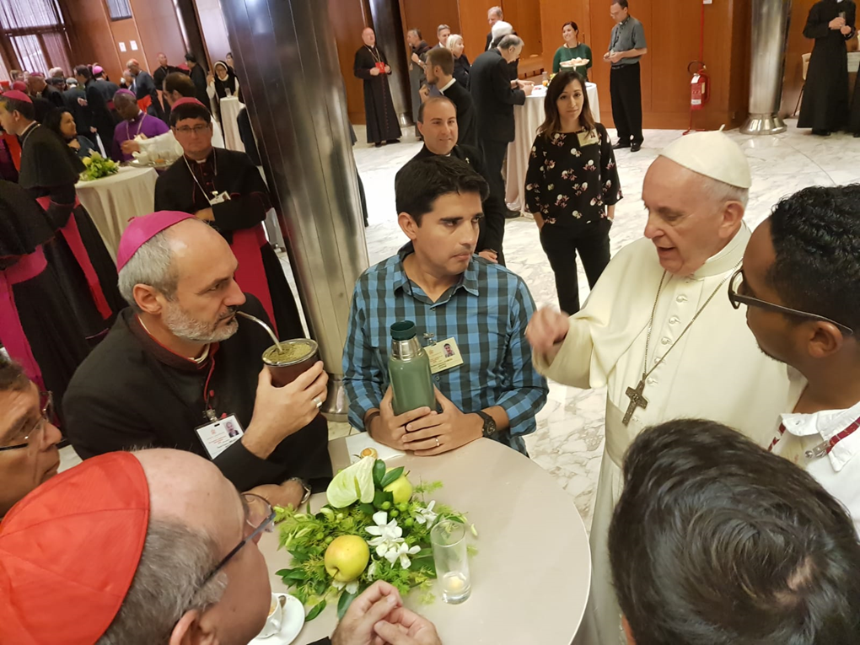
10
Concluding Thoughts
It’s a journey together! Its Walking together , listening to each other and all listening to the Holy Spirit .
The process of synod is as equally important as the product of the synod!
Synodality is the form, lifestyle and the structure of the Church. (PD,2)

Slide 21


